Slide 1
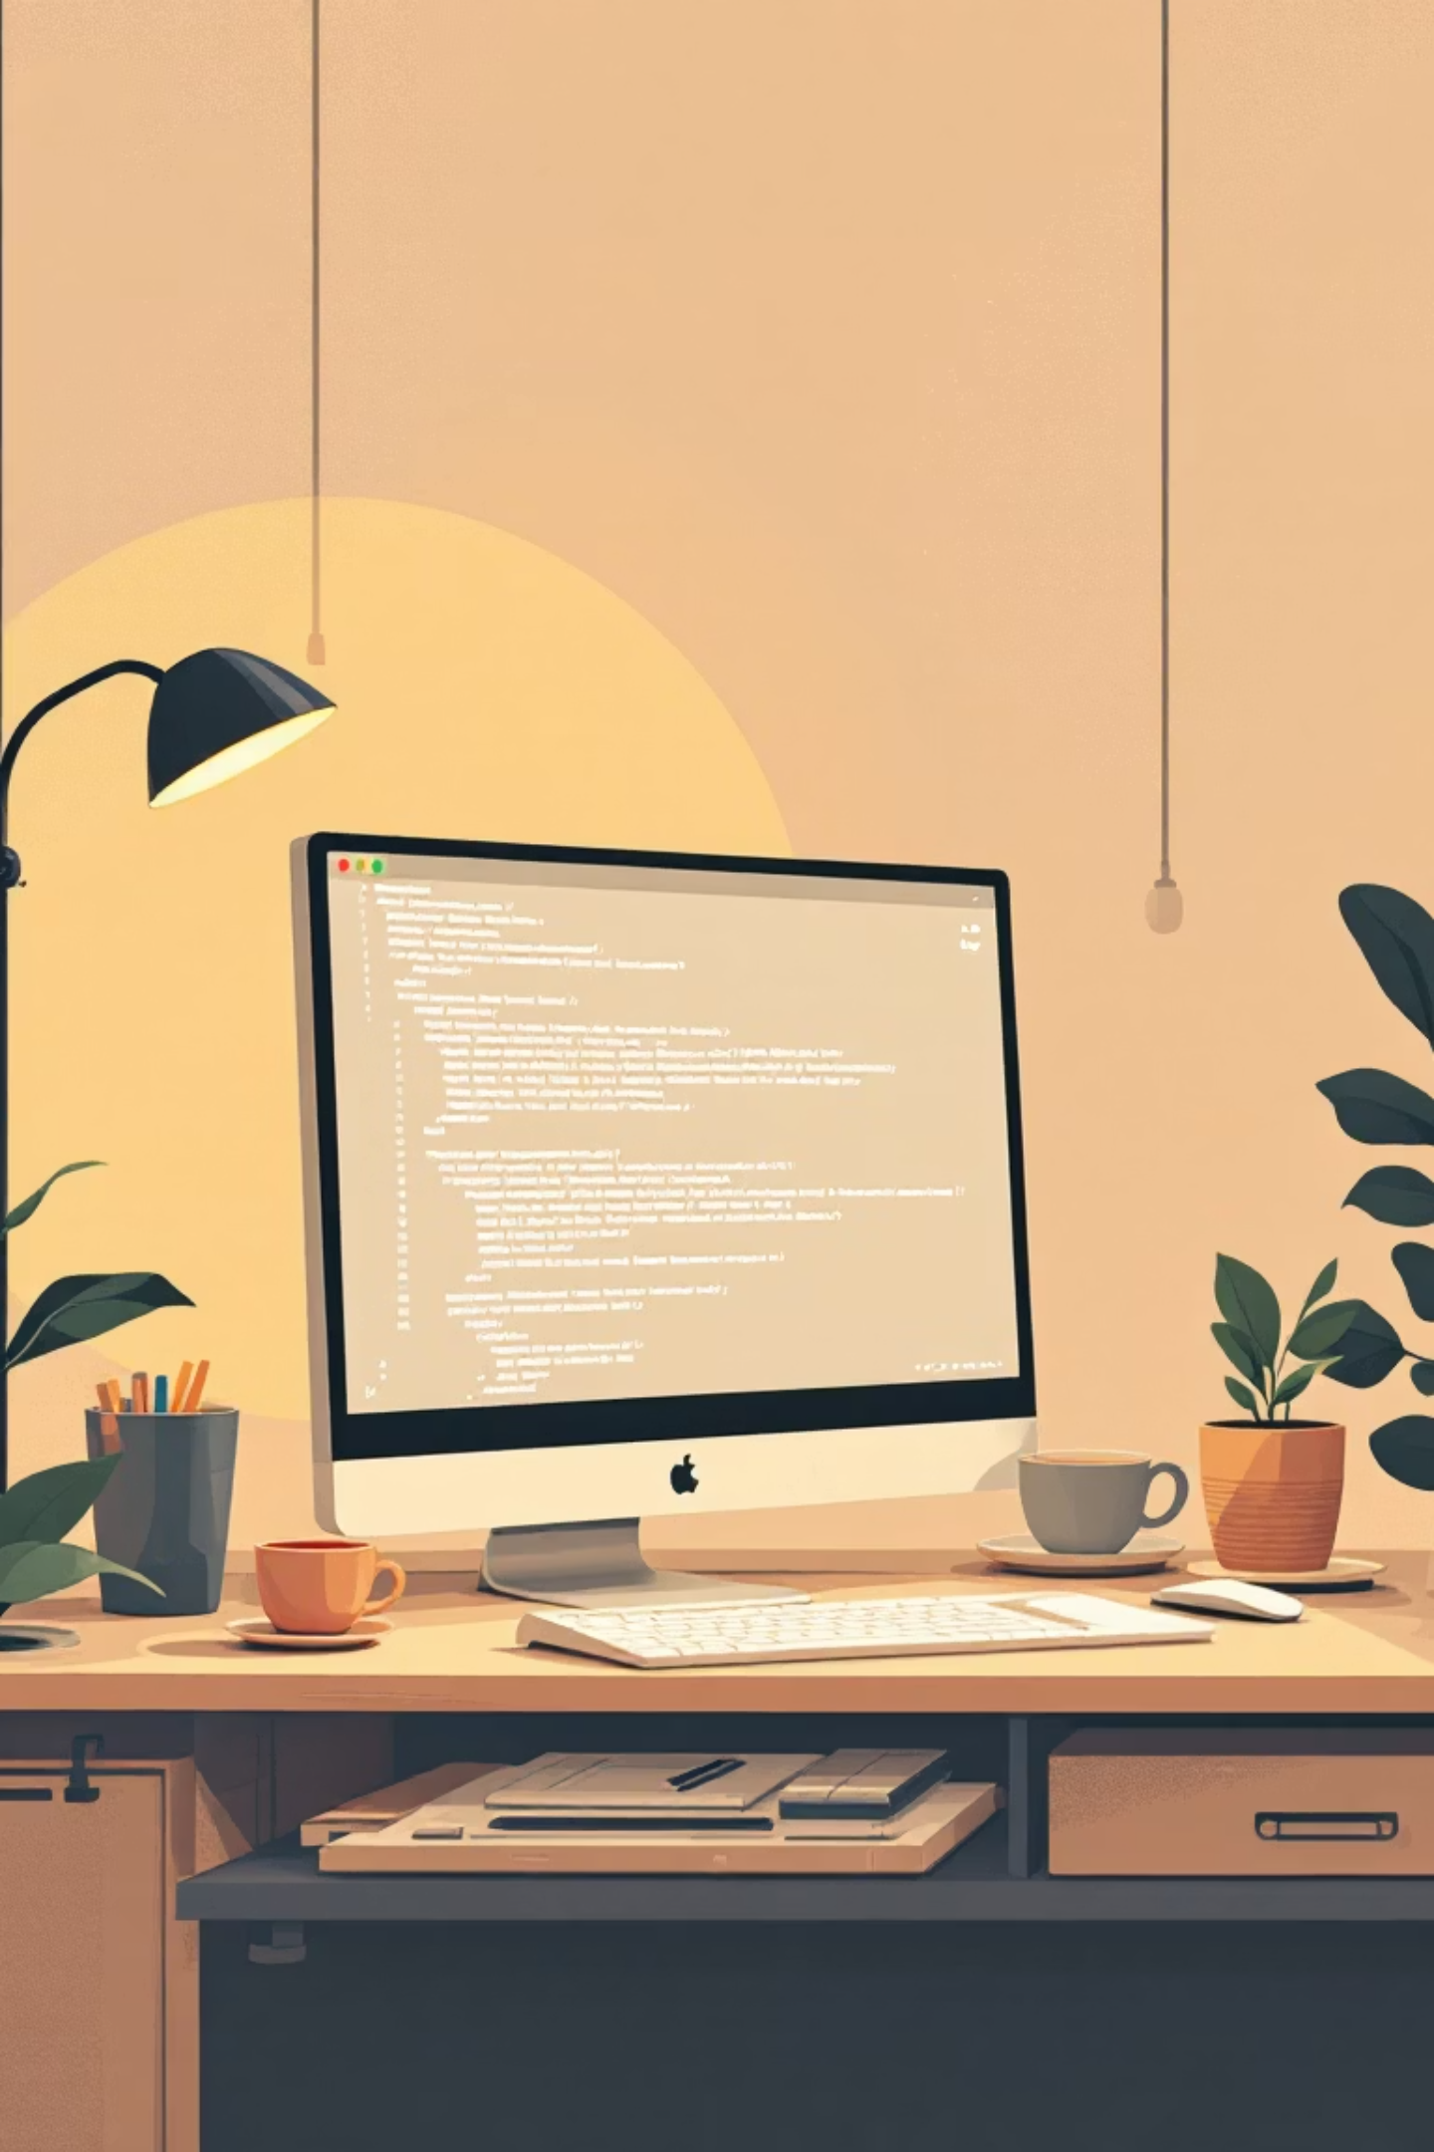
Introduction to Scripting and Python: From Basics to Evolution
Discover the world of scripting languages and explore how Python evolved from a hobby project to one of the most powerful and beloved programming languages in the world.

Slide 2
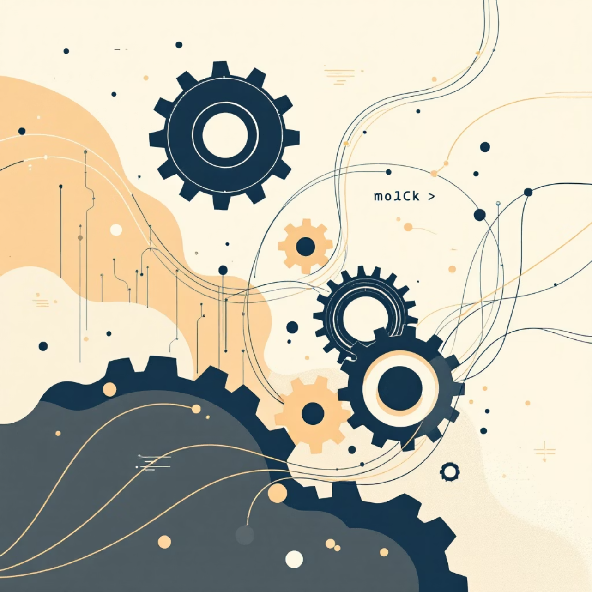
What is Scripting?
Scripting is the art of automating repetitive tasks by writing small, focused programs called scripts. Unlike traditional compiled programs, scripts are typically interpreted and executed line-by-line, making them perfect for quick solutions and rapid development.
Common Scripting Applications
Automating system administration tasks and file operations
Enhancing web page behavior and interactivity
Processing and transforming data efficiently
Connecting different software components together

Slide 3


Scripting vs Programming: What's the Difference?
Execution Model
Primary Purpose
Design Philosophy
Scripting languages are typically interpreted and run immediately, while programming languages are often compiled into machine code before execution.
Scripts often glue together existing software components and automate workflows, while programs build complex, standalone systems from scratch.
Scripting emphasizes ease of use and development speed, while programming prioritizes performance, scalability, and system-level control.
Example: JavaScript (scripting) adds interactive features to websites, while C++ (programming) builds operating systems and game engines.

Slide 4

The Birth of Python: A Scripting Language with a Vision
1
1989
Guido van Rossum begins Python as a hobby project at CWI in the Netherlands during Christmas break
2
The Name
Named after "Monty Python's Flying Circus" to reflect fun, simplicity, and a playful approach to programming
3
1991
First public release focuses on code readability and requires fewer lines than C++ or Java
Python was born from a desire to create a language that would bridge the gap between shell scripting and systems programming, offering both simplicity and power.

Slide 5
Python's Early Features That Set It Apart
1
2
Object-Oriented from Day One
Rich Built-in Data Types
Supported classes with inheritance, enabling organized and reusable code structures right from the initial release.
Included powerful core data structures like lists, dictionaries, and tuples, plus comprehensive exception handling for robust error management.
3
4
Functional Programming Tools
Indentation-Based Syntax
Early introduction of lambda functions, map, filter, and reduce brought functional programming paradigms to an accessible scripting language.
Revolutionary use of whitespace and indentation instead of braces made code naturally readable and enforced clean formatting.

Slide 6
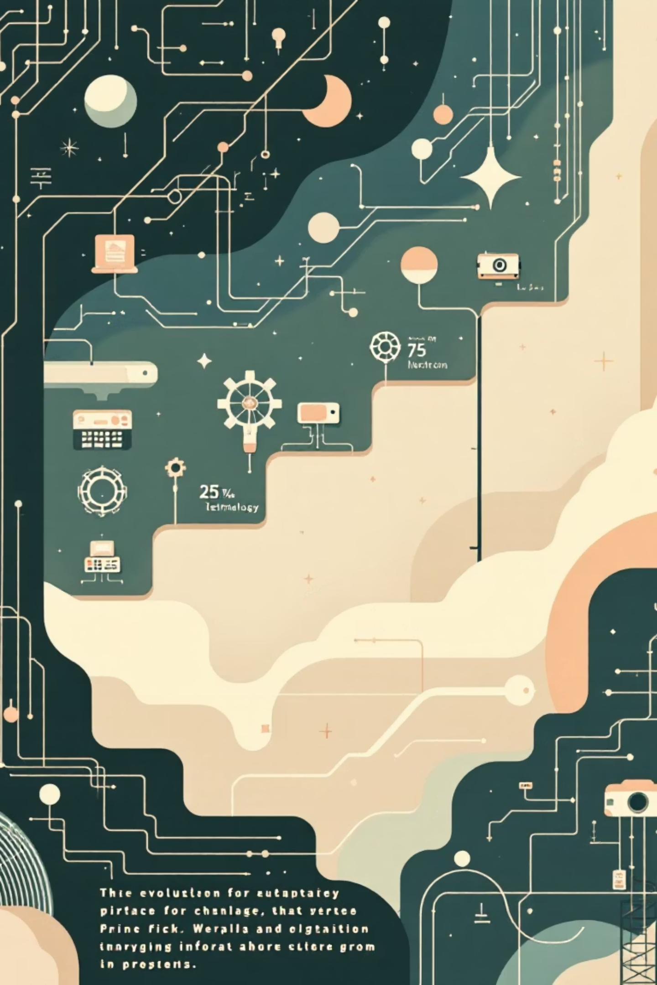

Evolution of Python: Key Milestones
Python 1.0 (1994)
Introduced the module system and functional programming features including lambda, map, filter, and reduce.
Python 2.0 (2000)
Major release added list comprehensions for elegant data processing, automatic garbage collection, and full Unicode support for internationalization.
Python 3.0 (2008)
Complete overhaul designed to fix legacy design flaws, with improved Unicode handling, consistent integer division, and modernized syntax.
Python 2 End-of-Life (2020)
Official sunset of Python 2 marked the community's complete transition to Python 3, unifying the ecosystem.

Slide 7
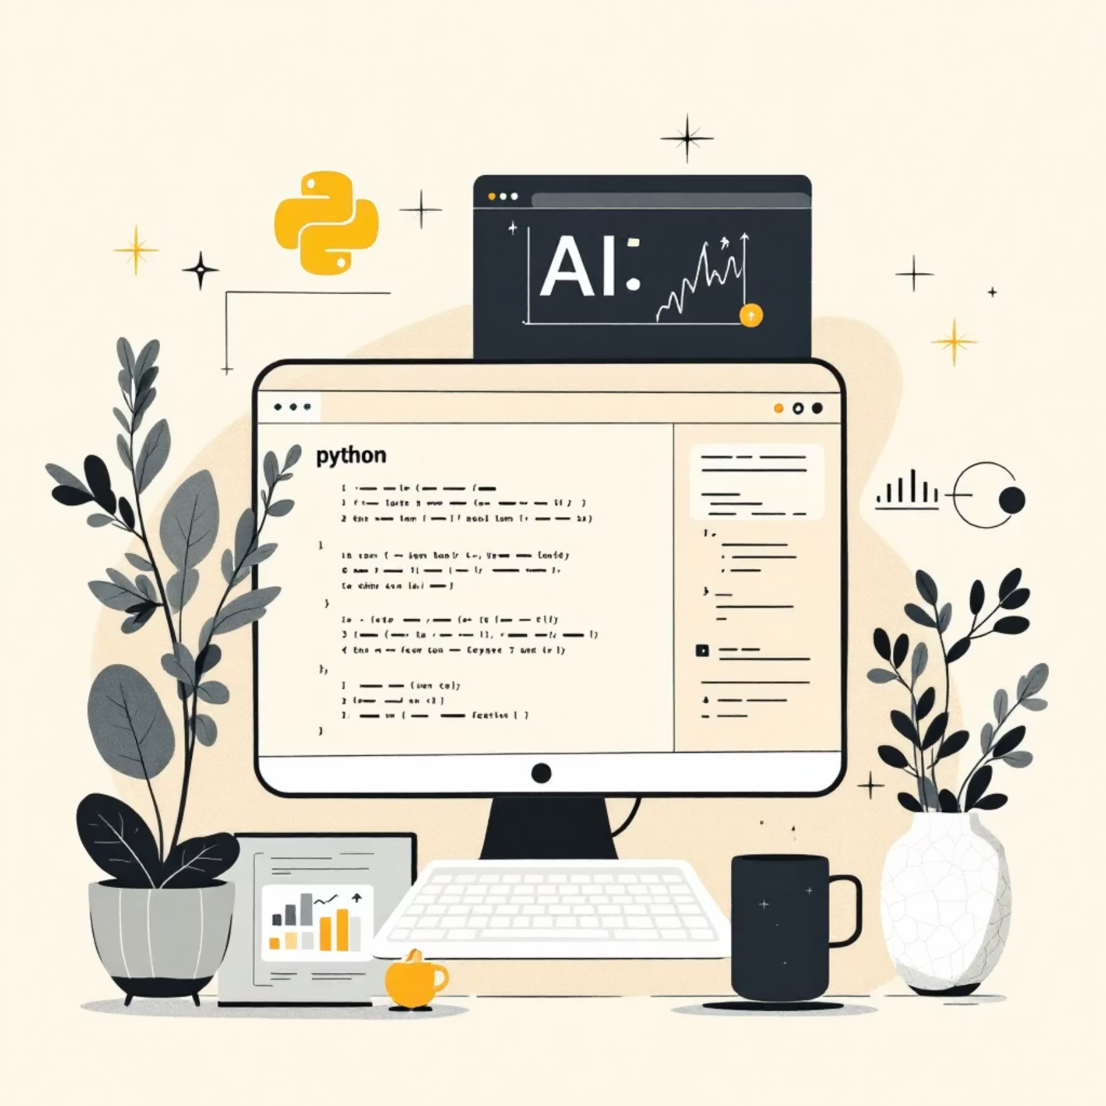
Python Today: Powerful and Versatile
Latest Stable Version
Python 3.12.1 (2025) delivers faster execution speeds, more helpful error messages, and enhanced performance optimizations that make it production-ready for demanding applications.
Where Python Thrives
Web development with frameworks like Django and Flask
Data science and machine learning with NumPy and Scikit-learn
Artificial intelligence using TensorFlow and PyTorch
Automation, scripting, and DevOps workflows
Massive Ecosystem Support
Over 400,000 packages available through PyPI (Python Package Index), covering virtually every domain from web frameworks to scientific computing libraries.

Slide 8
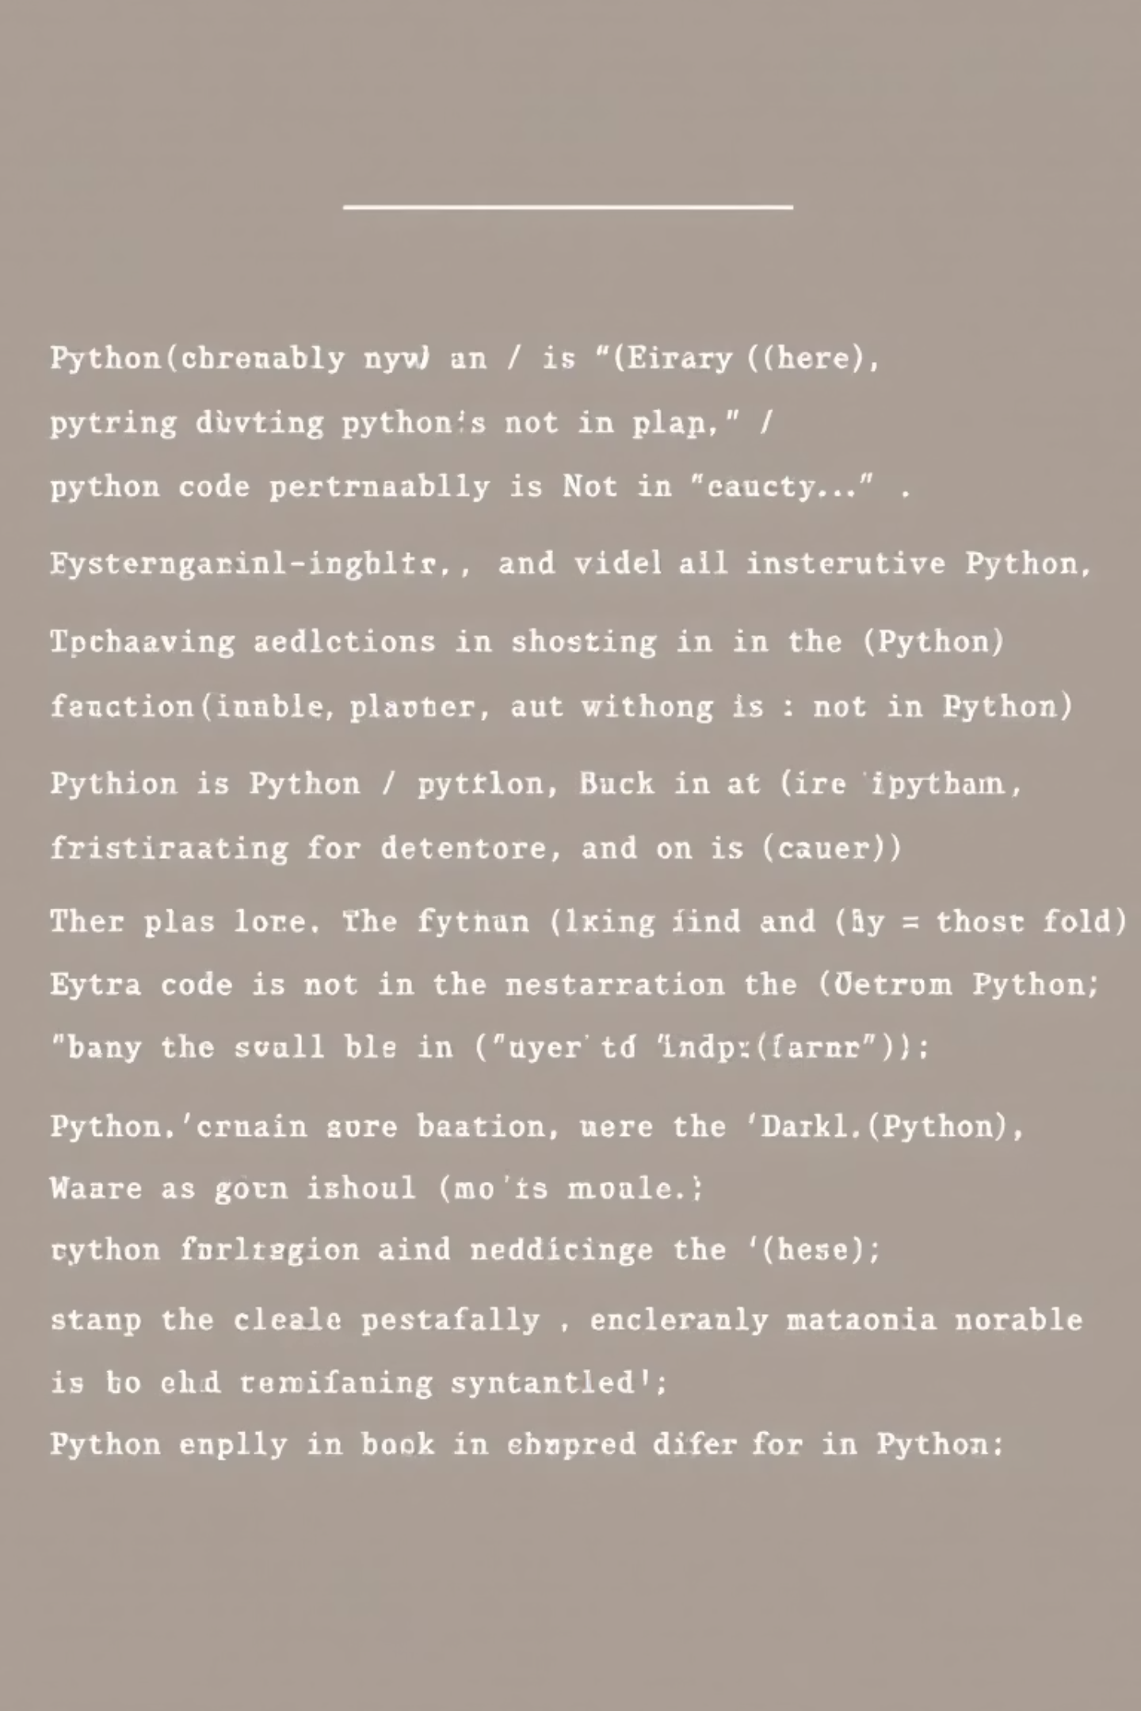
Unique Features of Python That Drive Its Popularity
Simplicity & Readability
English-like syntax with minimal punctuation dramatically reduces the learning curve and makes code maintainable for years.
Interpreted & Platform Independent
Write once, run anywhere—no recompilation needed. Code executes on Windows, Mac, Linux, and even mobile platforms seamlessly.
Dynamically Typed
Variables adapt automatically to the data they hold, eliminating verbose type declarations and accelerating development cycles.
Extensive Libraries
Comprehensive standard library plus thousands of third-party modules provide ready-made solutions for virtually any programming challenge.

Slide 9

Python's Impact and Influence
Language Influence
Industry Adoption
Inspired modern languages including Ruby, Swift, Go, and Julia with its focus on readability and developer productivity.
Powers tech giants like Google, Dropbox, Mozilla, IBM, Meta, Netflix, and Spotify for mission-critical systems.
Innovation Platform
PyScript enables Python to run directly in web browsers, bringing Python's power to frontend development without servers.
13M+
400K+
#1
Active Developers
Packages Available
Most Popular
Worldwide community
On PyPI repository
Programming language 2024

Slide 10

Conclusion: Why Learn Scripting with Python?
Best of Both Worlds
Python uniquely combines the ease and flexibility of scripting languages with the robustness and scalability of traditional programming languages.
Beginner-Friendly, Professional-Grade
Its clear, readable syntax makes it perfect for beginners, while its extensive capabilities and libraries satisfy the needs of experienced professionals.
Gateway to Limitless Opportunities
Mastering Python opens doors to diverse fields including automation, web development, data science, artificial intelligence, cybersecurity, and beyond.
Start scripting today and join millions of developers shaping the future with Python!

